Slide 1

Preparing For The Future
OIT’s Application Data Access strategy

Slide 2

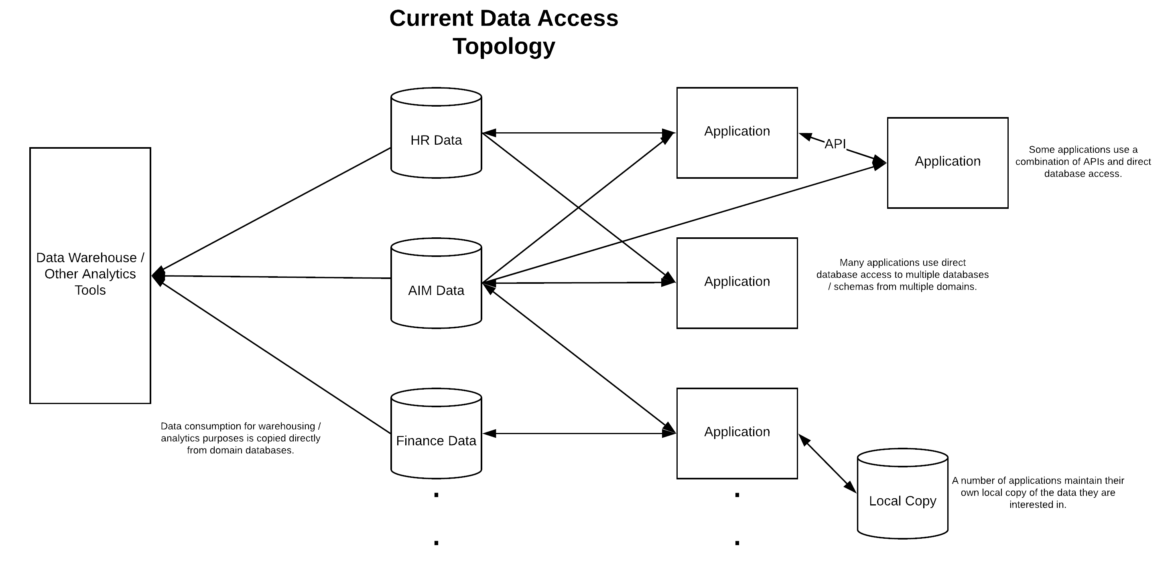




Slide 3
Current State
Direct database access (Antipattern)
Tight coupling to the database schema of the application
Internal business practices leak into the consumer
Usually limited to relational databases
Purchased cloud based systems usually use APIs for access
Course grained access control
Increased blast radius of a security breach

Slide 4
Current State
Data Extracts (Antipattern)
General Purpose or custom for consuming system
Only as current as the last extract time
All or nothing access policy
Custom extracts increase coupling between systems

Slide 5
Current State
Calling Domain APIs (Better)
Tightly coupled to the business model of the domain
Different API methodologies and philosophies between applications
Different authorization schemes

Slide 6
Façade Pattern
The facade pattern (also spelled façade) is a software-design pattern commonly used in object-oriented programming. Analogous to a facade in architecture, a facade is an object that serves as a front-facing interface masking more complex underlying or structural code. (Wikipedia)

Slide 7
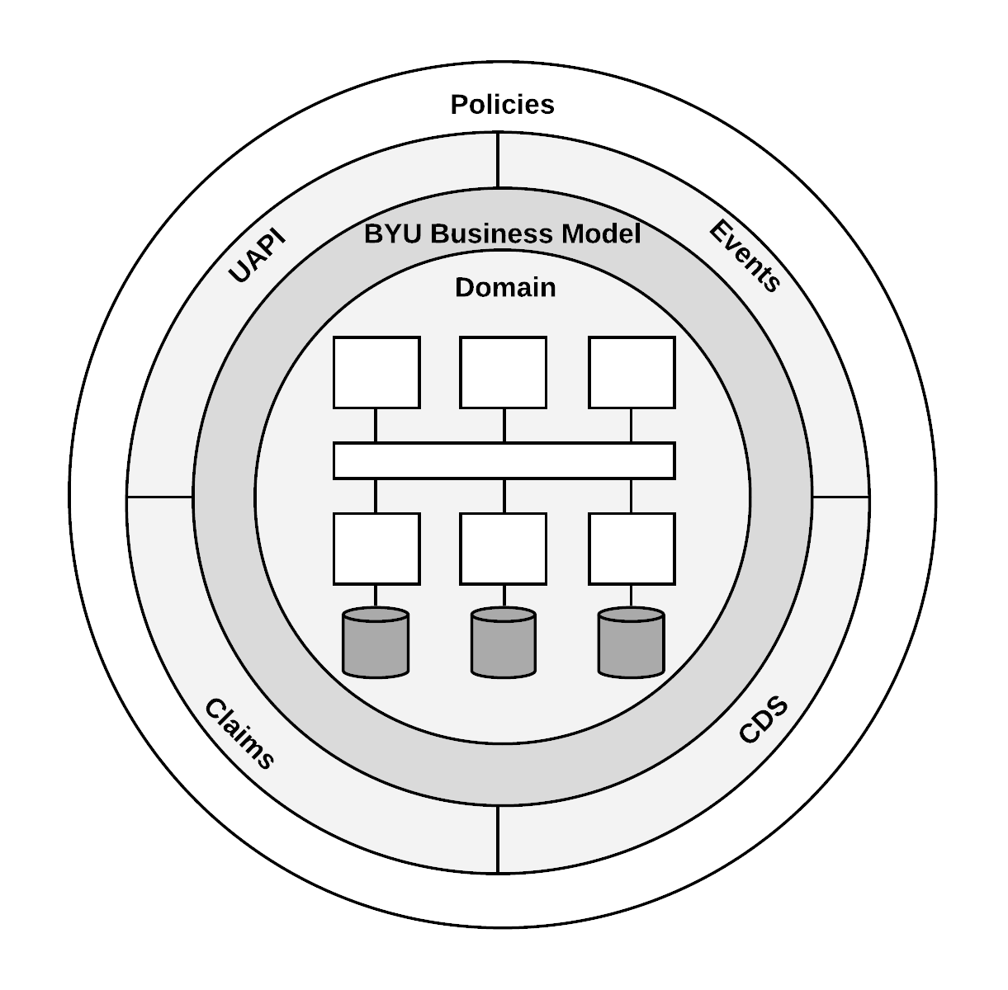
OIT’s Application Data Sharing Strategy
Multilayered approach heavily relying on the Façade Pattern to provide isolation between providing and consuming domains.

Slide 8
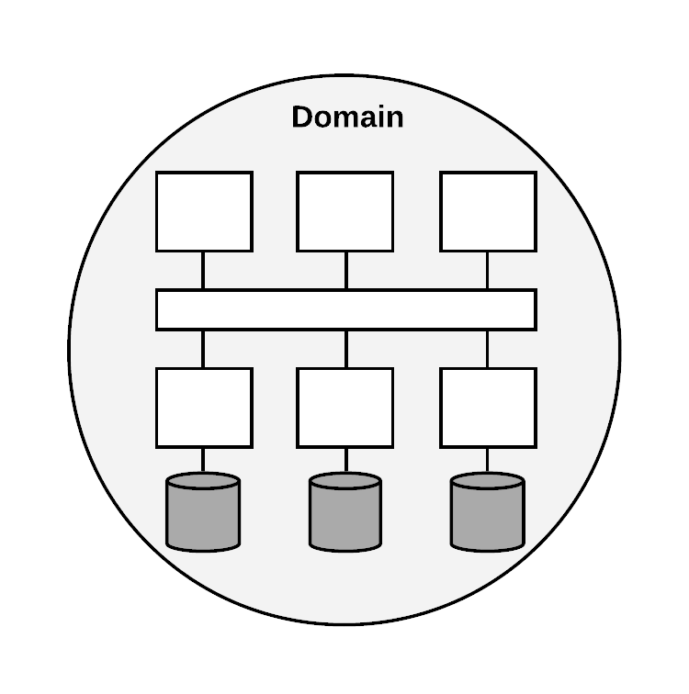
Domains
Based upon Eric Evans Domain Driven Design
Some aspect of university business implemented in software
Need to interact with other software systems (domains) to perform some business function
May or may not be equivalent to a traditional application
Have own data stores
All interaction with other domains through well defined facades

Slide 9
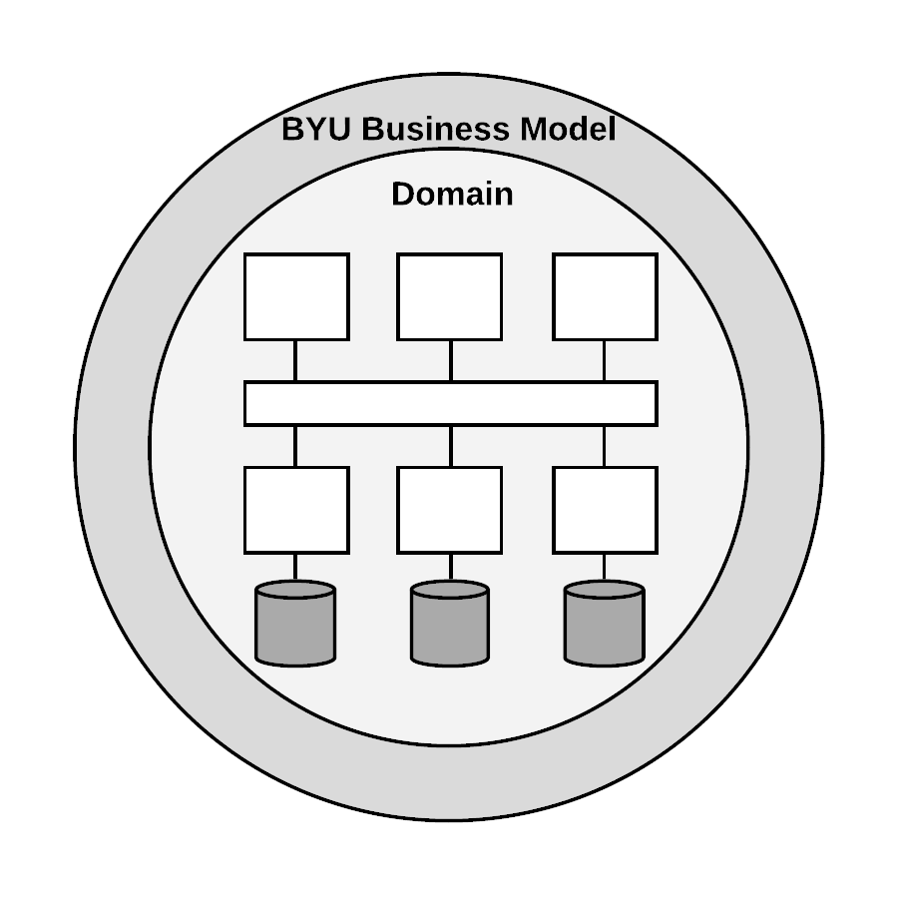
Business Model
Provide a consistent view of business concepts
BYU specific
Hides internal domain details

Slide 10
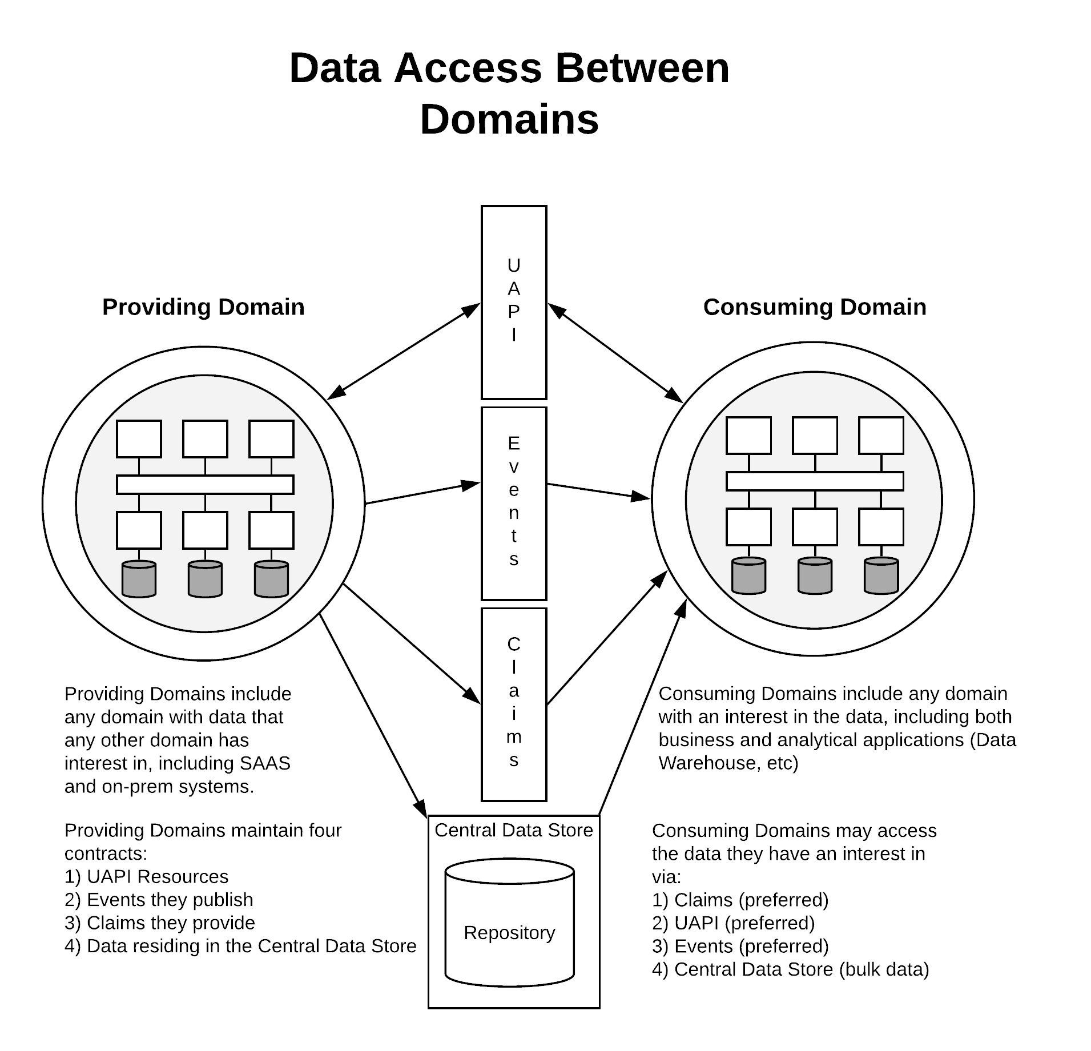
Data access between domains
UAPI
Events
Claims
Central Data Store
Notes:
CDS is the only method with its own repository. All other are (near) real time.

Slide 11
University API
REST API
Real time access
Resources based upon common BYU business model concepts – Students, Instructors, Employees, etc
All interactions follow a defined standard
Only method for updating providing domain data

Slide 12
Events
Notification that something of interest happened within a domain such as a grade posted, address changed, or class has been added by a student
Contains information about the originator of the event and the subject of the event
Subscription based
Push or Pull model

Slide 13
Claims
True / False questions
Isolates the consumer from the business logic and data of the provider
Implemented as REST API calls

Slide 14
Central Data Store
Database based façade reflecting the BYU business model of the domain
Read only by consumers
Applications consume the data via traditional database methods
Used when consuming systems cannot use other methods
Bulk loads
3rd party software
May not be real time (domain dependent)

Slide 15
Policies
Govern all access to data regardless of the delivery method
Use attributes about the consumer and the subject of the data to determine access (ABAC)
Defined by the Data Stewards
Expressed in terms of the BYU Business Model
Implemented in the applicable technology for the access method

